Slide 1
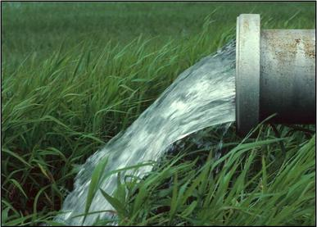
SMART METERING SOLUTIONS
Empowering the Agricultural Sector
SMART CONTROL
SMART MONITORING
SMART PLANNING
Rowan Everts & Zane Zandberg
19 July 2018

Slide 2
WHO WE ARE
A proudly South African company with the aim to become an independent pioneer in the smart metering industry in South Africa by utilizing World Wide technology.
Zane Zandberg (business development)
Rowan Everts (technical development)
We believe in innovative, sustainable and cost-efficient solutions providing our customers with intelligent, robust and convenient feedback on how to better manage their resources.

Slide 3
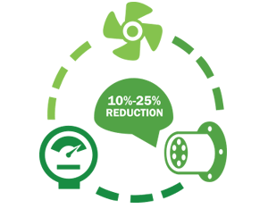
OVERVIEW
Background & Needs
Water meter types
Solutions: Communication
Solutions: Analyze & Plan
Solutions: Apply Control
Summary

Slide 4
BACKGROUND & NEEDS
Comply with DWS metering regulations for irrigation purposes
Standards and accuracy
Site investigation, selection and design
Measure, record and report
Retain data for a minimum of 5 years
Collect meter data remotely
Linking measurement with control
Reduce response time with problems
Make intelligent decisions regarding water usage
Create District Metering Areas (DMAs) and optimize
Improve financial gain in the long run
Positively impact the environment

Slide 5
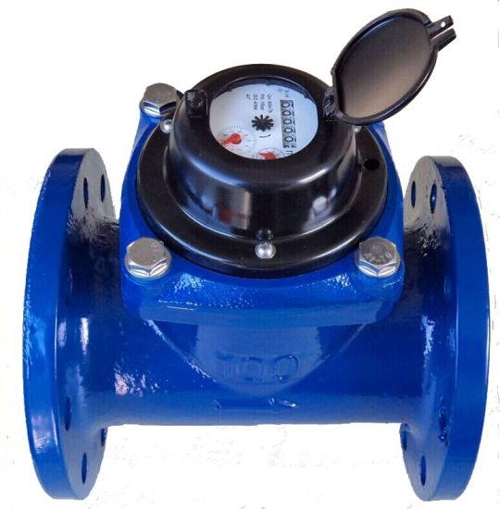
WATER METER TYPES
MECHANICAL
WOLTMAN TYPE
Supply networks, agricultural, industrial
Accurate
Size 50 - 300 mm
Flow rate qpermanent 50 - 1000 m3/h
Measurements:
- Accumulative
- Real time flow
Straight pipe requirement
SIZE | 50 | 65 | 80 | 100 | 150 | 200 | 250 | 300
SPR | 5 d before & 2 d after | 10 d before & 5 d after

Slide 6
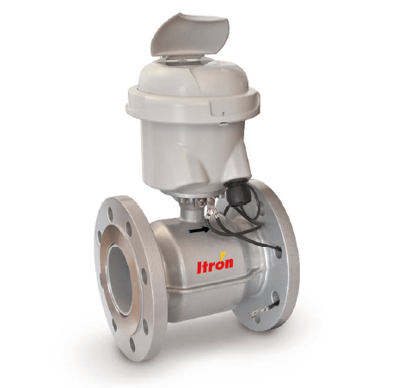
WATER METER TYPES
ELECTROMAGNETIC
SharpFlow
Sewage systems, agricultural, industrial
Accurate
Size 25 - 300 mm
Flow rate qpermanent 10 - 1600 m3/h
Measurements:
- Accumulative
- Real time flow
- Numerous outputs available for connecting SharpFlow to different recording/analysing systems.
Straight pipe requirement
SIZE | 50 | 65 | 80 | 100 | 150 | 200 | 250 | 300
SPR | 5 d before & 2 d after | 10 d before & 5 d after

Slide 7
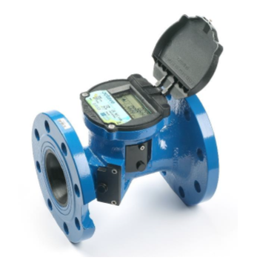
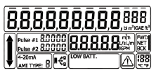
WATER METER TYPES
ULTRASONIC
OCTAVE
Agricultural, industrial, low quality water
Accurate, Reliable
Size 50 - 300 mm
Flow rate qpermanent 40 - 1000 m3/h
Measurements:
- Accumulative
- Real time flow
- LCD Programmable Display
- Flexible Data Formats
Straight pipe requirement
SIZE | 50 | 65 | 80 | 100 | 150 | 200 | 250 | 300
SPR | Minimal to Zero D depending on installation

Slide 8
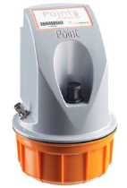
Solutions: Communication
1. Collect
2. Communicate
3. Control
4. Maintain
Remote telemetry units (RTUs) for monitoring
Mains & battery powered
Easy installation and maintenance
Pulse, Mod-Bus, 4-20 mA
Installation in existing pump houses or pits
GPRS reception needed
Transmits measurements to central collection point

Slide 9
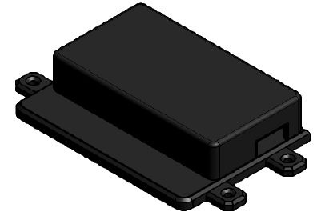
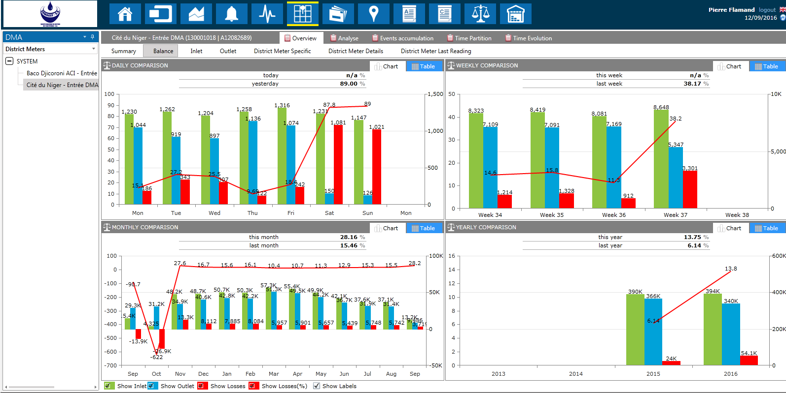
Solutions: Analyze & Plan
Remote monitoring of meters
Accumulative flow (m3) & flow rate (m3/h)
Analyze water trends & water balances with DMAs
Set overflow thresholds & custom alarms

Slide 10
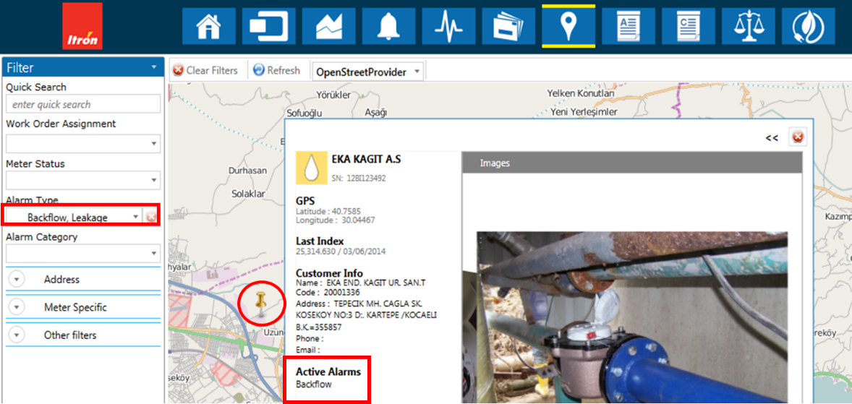
Solutions: Apply Control
Control units (CUs) for monitoring and control
200x200x150 mm CU IP67 box
Control assets & performance
Email / SMS
Review installation
Assign work-orders from portal

Slide 11
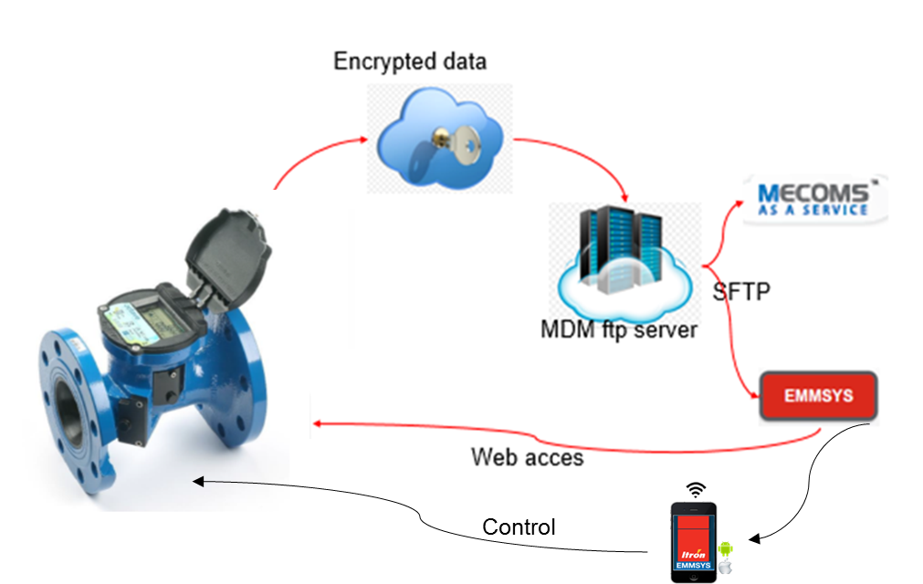
Summary
One access point
Visualization, reporting and decision support
Flow usage trends
Custom alarms
Control assets, network and performance

Slide 12
Questions

Slide 13
We provide the full service and installation
24/7 Service & Support
Contact us
Office: +27(0) 66 3022819
admin@zzeesmetering.com
Zane Zandberg: +27(0) 71 3638263
zane@zzeesmetering.com
Rowan Everts: +27(0) 76 0612903
rowan@zzeesmetering.com
Website: www.zzeesmetering.com

